Slide 1
Facial Emotion Analysis for Instant Audience Feedback
VINAKOLLU GOKUL – 2010030181
DEPA SAI CHARAN REDDY – 2010030038
KATTA LAKSHMI NARASIMHA – 2010030458
NAGULAPATI YASHWANTH REDDY - 2010030235

Slide 2
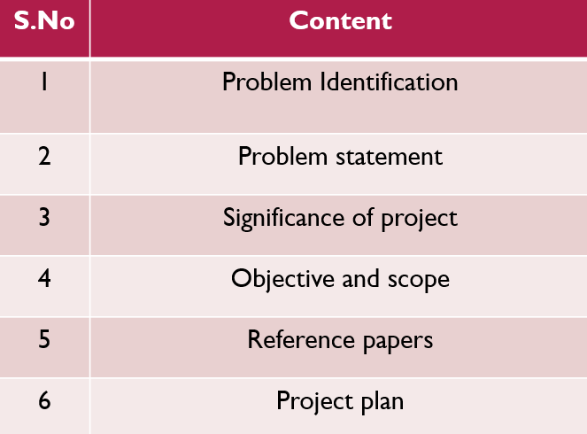
OVERVIEW

Slide 3
1.PROBLEM IDENTIFICATION
Presenters often struggle to gauge audience engagement and understanding in real-time.
Lack of immediate feedback hinders effective communication and adjustment during presentations.
Real-time emotional insights can guide presenters to adjust their pace, tone, and content to maintain engagement.
Beyond traditional presentations, facial emotion analysis can be applied to training sessions, workshops, and virtual meetings , movie reviews,class feedbacks etc..

Slide 4
2.PROBLEM STATEMENT
This project addresses the critical need for reliable and real-time expression detection in crowded scenes, such as public spaces, classrooms, or workplaces. Accurate emotion analysis has diverse applications, from improving human-computer interaction to enhancing emotional awareness in social contexts.
The project aims to address this challenge by harnessing the power of computer vision and deep learning techniques, specifically leveraging the Keras framework. The primary focus is on developing a robust system capable of detecting and analyzing emotions on the faces of multiple individuals in real-time during presentations. By implementing a comprehensive solution that accurately identifies a range of emotions, including happiness, surprise, sadness, and more, presenters will gain valuable insights into the audience's reception and engagement levels.

Slide 5
3.Significance of the project
Deeper Understanding of Emotions:
Facial expressions are a primary way humans express emotions. By analyzing these expressions, you can gain a deeper understanding of how people feel and react to different situations, products, services, or events.
Non-Intrusive Data Collection:
Facial emotion recognition technology can collect data non-intrusively, often without requiring direct interaction with participants. This minimizes the risk of influencing participants' responses.
If helps for society for many ways like product and service improvement ,movie reviews,public engagement etc..

Slide 6
4.OBJECTIVE OF THE PROJECT
The objective of this project is to develop a facial emotion recognition system that can be used to provide instant audience feedback during presentations. This system would use machine learning to identify different emotions, such as bored, confusion, interest, and engagement, from the facial expressions of audience members. The presenter would then be able to use this feedback to adjust their presentation accordingly, ensuring that they are communicating effectively and keeping their audience engaged.

Slide 7
5.SCOPE OF THE PROJECT
The primary scope of this project is to establish a model that can classify seven basic emotions: happy, sad, surprise, angry, disgust, neutral, and fear and to achieve the accuracy better than the baseline.
the project will develop a robust system capable of real-time emotion recognition from the facial expressions of audience members. The system will analyze subtle cues such as smiles, frowns, and raised eyebrows to gauge the audience's emotional engagement and comprehension levels. The captured emotional data will be translated into meaningful insights, enabling presenters to adapt their delivery in response to the audience's reactions.

Slide 8
References Table
NO. | AUTHORS | TITLE | Volume No. | YEAR
1. | Wafa Mellouk a, Wahida Handouzi a | Facial emotion recognition using deep learning: review and insights | Volume 107 | 2020
2. | Shan Li, Weihong Deng | Deep Facial Expression Recognition: A Survey | Volume: 13 | 2022
3. | PeterBurkert,felix Trier, Muhammad Zeshan Afzal, Andreas Dengel | DeXpression: Deep Convolutional Neural Network for Expression Recognition | Volume 2 | 2016
4. | D Y Liliana | Emotion recognition from facial expression using deep convolutional neural network | Volume 18 | 2018
5. | Shima Alizadeh, Azar Fazel | Convolutional Neural Networks for Facial Expression Recognition | Not mentioned | 2017

Slide 9
Implementation
TRAINING PROCESS
REAL TIME PROCESS
Webcam
Input from database for training
Test data
FACE DETECTION(OPENCV)
FEATURES EXTRACTION
CLASSFICATION
CLASSIFIER
EMOTION OUTPUT
FEEDBACK

Slide 10
THANK YOU

